Slide 1
Major Project Presentation
PRESENTED BY MUSKAN & SANDEEP(BTECH CSE 8TH SEM )
-SCHOOL OF ENGINEERING & TECHNOLOGY
PRESENTED TO :- DR. PARVEEN SEHGAL
- Professor of CSE Department

Slide 2
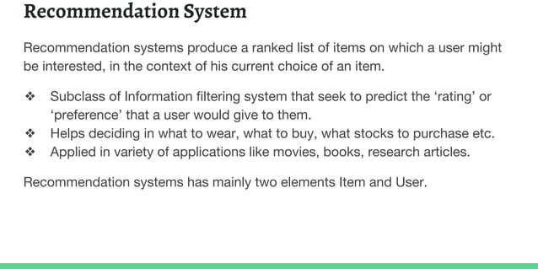

Slide 3
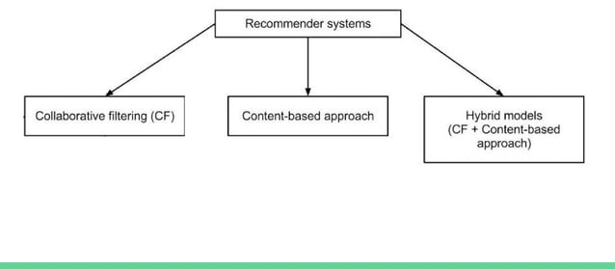

Slide 4
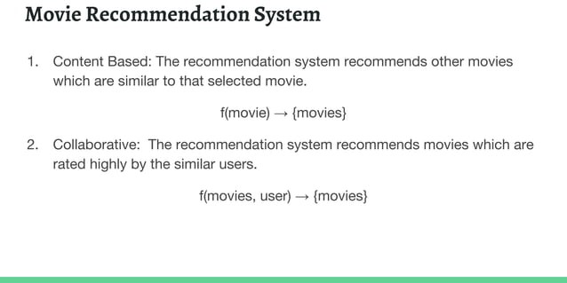

Slide 5
PROJECT STAGES
Setup project folder structure in jupyter notebook and install dependencies
Preprocessing
Model
Deploy
Website

Slide 6
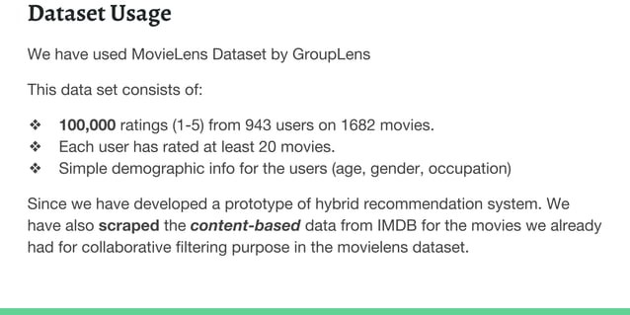

Slide 7
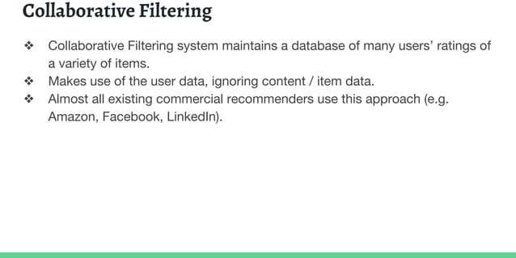

Slide 8
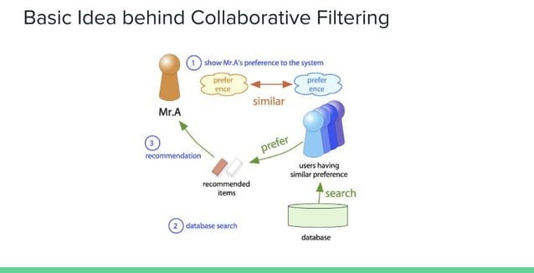

Slide 9
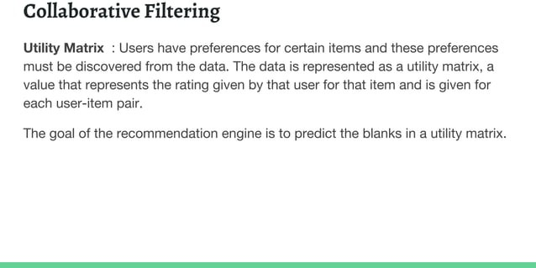

Slide 10
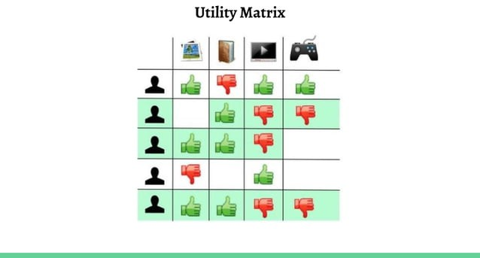

Slide 11
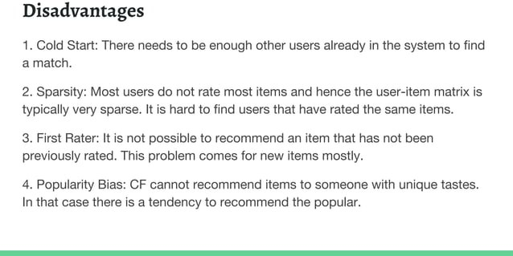

Slide 12
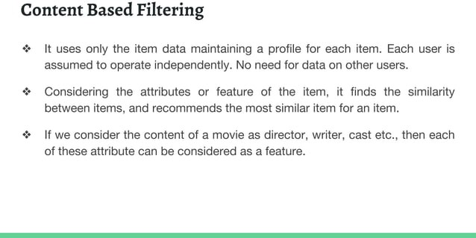

Slide 13
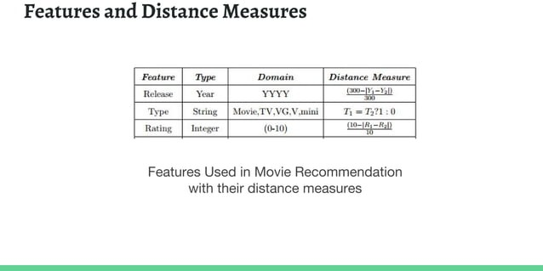

Slide 14
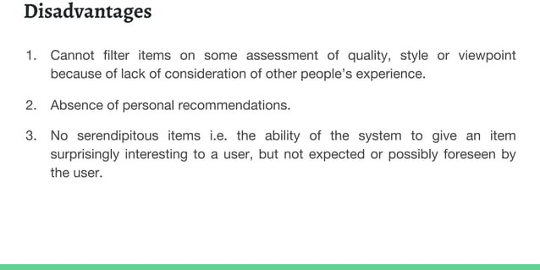

Slide 15
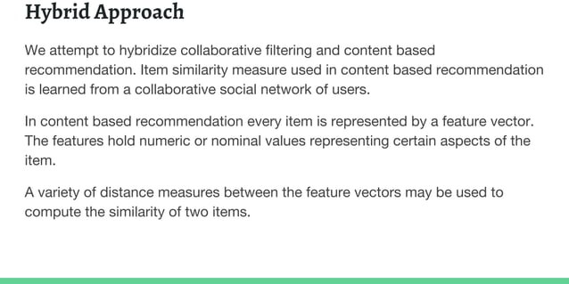

Slide 16
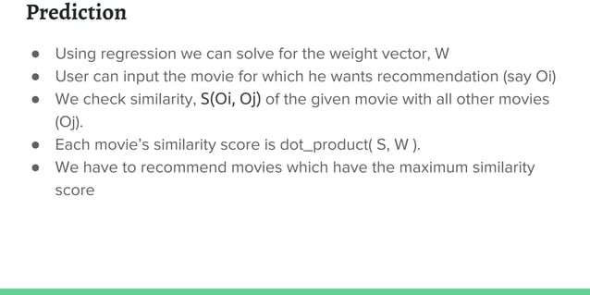

Slide 17


